Slide 1


National Mechanisms for
Implementation, Reporting and Follow-up (NMIRFs)
Capacity Building Programme
September 2025

Slide 2
Outline
What is a national mechanism for implementation, reporting and follow-up
Regional and international developments on NMIRFs
HRC report content and findings

Slide 3

What is a national mechanism for implementation, reporting and follow-up

Slide 4
What is a National Mechanism for Implementation, Reporting and Follow-up
  A government structure with a mandate to:
  Coordinate the preparation of reports to and engagement with international and regional human rights mechanisms (including treaty bodies, the universal periodic review and special procedures)
  Coordinate and monitor national follow-up and implementation of treaty obligations and recommendations/ decisions from these mechanisms.
Notes:
A national mechanism for reporting and follow-up is a national public mechanism or structure that is mandated to coordinate and prepare reports to and engage with international and regional human rights mechanisms (including treaty bodies, the universal periodic review and special procedures), and to coordinate and track national follow-up and implementation of the treaty obligations and the recommendations emanating from these mechanisms. It may be ministerial, interministerial or institutionally separate.
The national mechanism performs these functions in coordination with ministries, specialized State bodies (such as the national statistics office), parliament and the judiciary, as well as in consultation with the national human rights institution(s) and civil society. The national mechanism for reporting and follow-up is often based within the ministry of foreign affairs, or liaises closely with it, as this ministry is usually responsible for overseeing relations between the national public administration and the international and regional systems.
NMRF is not an NHRI
NHRI is independent, State funded organization with broad mandate to promote and protect human rights, incl submit recs and raise awareness
NMRF is a mechanism or structure that is fully part of the Government, with a mandate that is closely tied to reporting to and engaging with international and regional human rights mechanisms, as well as following up their recommendations or decisions.
We have observed in the Study that NHRIs do play an important role in NMRFs (though often independent), for example during consultations. However, NHRIs have an independent role (participation in NMRF meetings as observers / participants without vote, submission of parallel reports and separate role in UPR process)
NHRIs and NMRFs are therefore complementary elements of a national hr protection system

Slide 5
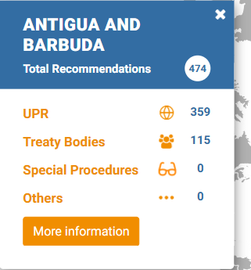
Rationale for institutionalizing
State engagement with human rights mechanisms
Timely and quality reporting demands sustainable technical expertise
  Ongoing growth in human rights mechanisms (int’l and regional), reporting requirements, and number of human rights recommendations addressed to States
  Quality reporting requires obtaining relevant information and data from different sources
Effective follow-up by different parts and levels of government
  Implementation of the outcome of mechanisms requires processes at the national level not just for transmitting recommendations to relevant ministries, to the parliament and other bodies, but also the integration of response actions in policies, plans, etc.
  Ongoing monitoring of the implementation of recommendations
Ad-hoc arrangements are not viable and do not lead to effective implementation
Notes:
- International and regional reporting require political commitment, technical knowledge and dedicated resources and capacity.
- The number of recommendations from human rights mechanisms which States are to implement is enormous- give example of country of capacity building effort, e.g. in your country alone … recommendations issued by UPR, …. By TBs… and … by SPs- totalling to …. recommendations.
- States that use ad hoc mechanisms to prepare their reports typically face the same capacity constraints every time they constitute a new drafting committee and face challenges caused by a lack of coordination and a weak institutional memory.
- Treaty Bodies often face a delay between reception of a report and its consideration, increasing the risk that Government drafters are no longer available for the interactive dialogue, thereby weakening institutional memory.
Consequently, ad-hoc arrangements are not viable anymore.

Slide 6
Common practical challenges in the coordination of follow-up planning and reporting
Processing large numbers of complex recommendations and interlinked follow-up activities​
Assigning responsibility and generating ownership for implementation and status tracking​
Agreeing on standard operating procedures for developing follow-up action plans and drafting reports
Gathering information on the implementation status of follow-up activities​ to prepare reports
Loss of institutional memory due to staff turnover​

Slide 7
How can National Mechanisms function well?
Effective National mechanisms seem to have the following four key capacities:
Coordination capacity
Information management capacity
Consultation capacity
Engagement capacity

Slide 8
Coordination capacity
  Capacity and authority to disseminate information, and to organize and coordinate information gathering and data collection from government entities, but also other State actors such as the National Statistics Office, SDG implementation focal point “agency/Ministry”, Parliament and the Judiciary, for reporting and follow-up to recommendations.
  This may include:
  Solid mandate, terms of reference, and annual work plans engaging all relevant Ministries, the National Statistics Office and SDG focal point (lead agency/Ministry)
  Email lists and regular coordination meetings
  Use of templates for collecting information
  Standing procedures for coordination with Parliament
Notes:
The “how” it is done
Important :
network of human rights focal points.
routinized forms of coordination (such as inter-ministerial committees and working groups).
high visibility and a common intra-governmental understanding of its role. Ministerial-level support, either through a central location within the Executive or through direct participation of Ministers in the NMRF, for example at plenary meetings or draft report validation meetings, should undoubtedly contribute to this.
In her report to the 28th session of the Human Rights Council, the Special Rapporteur on adequate housing stated that international human rights mechanisms interact primarily with national level governments (A/HRC/28/62, 22 December 2014). She stated that trends toward decentralization and greater responsibilities for local and subnational governments have meant that States’ obligations under international human rights law rely increasingly on implementation by local and subnational government. The Special Rapporteur recommended that States encourage local and subnational level governments to actively participate in all relevant international human rights mechanisms, including treaty body review and complaint procedures, the universal periodic review and special procedures. She also recommended that recommendations emanating from international human rights mechanisms be communicated to local and subnational governments with requests for responses and follow-up action and disseminated to local communities in accessible form. It is therefore important that NMRFs put in place mechanisms of coordination with local and subnational levels of Government, in order to capture efforts undertaken at those levels.

Slide 9
Consultation capacity
  Capacity to foster and lead meaningful consultations with the country’s NHRI(s) and civil society including with marginalized groups.
This may include:
  Dedicated focal point for liaising with other stakeholders
  Establishing a mailing list
  Regular consultations with different stakeholders
  Participation of stakeholders in selected meetings (observer)

Slide 10





Coordination and consultation capacity- OHCHR tools
Human Rights: Handbook for Parliamentarians
-published jointly with the Inter-Parliamentary Union
Working with the United Nations Human Rights Programme: A Handbook for Civil Society
Civil Society Space and the United Nations Human Rights System
Webcasting of sessions (TBs/UPR), e.g. “public viewing” combined with possibly a panel discussion between State and civil society
How to Follow Up on United Nations Human Rights Recommendations

Slide 11
Information management capacity
The capacity to
track the issuance of recommendations and decisions by the international and regional human rights mechanisms
systematically capture and thematically cluster (including against SDGs) these recommendations
identify responsible Government Ministries and/or agencies for their implementation
develop implementation plans, which can feed into other national policies and plans, including timelines, with relevant Ministries to facilitate such implementation, and indicators

Slide 12

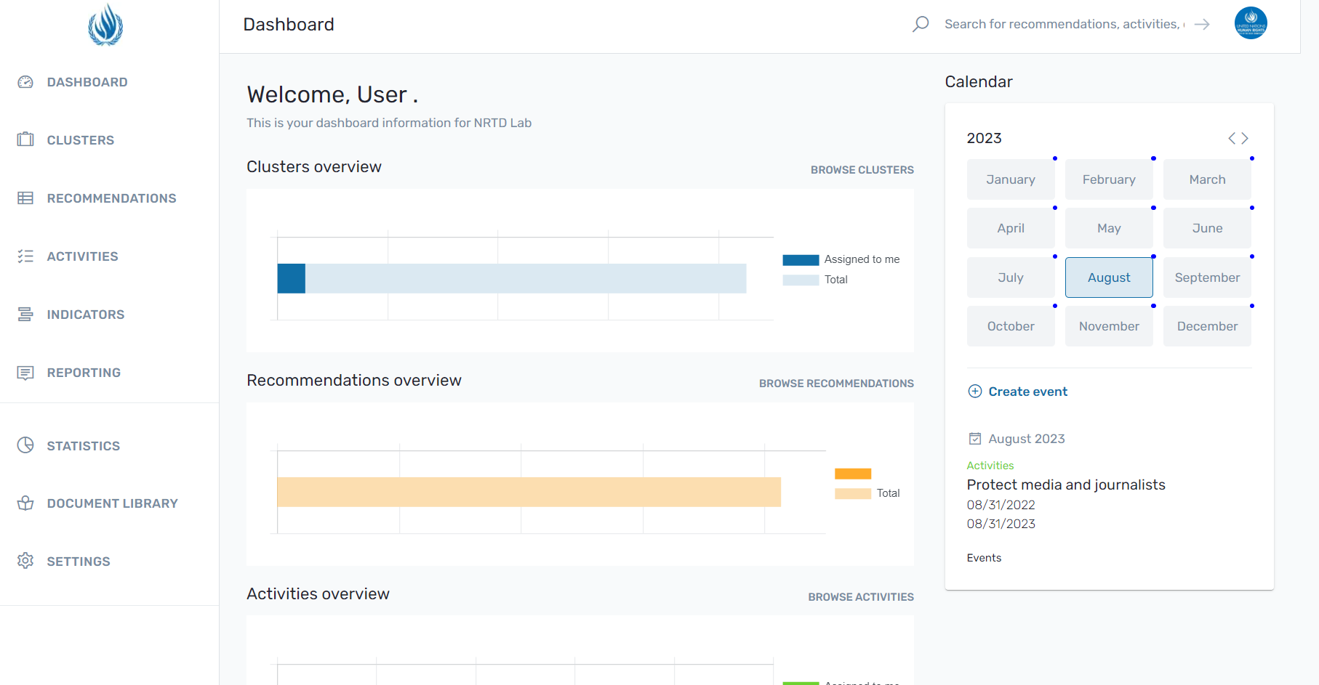
Information Management Capacity- OHCHR tools
https://www.youtube.com/watch?v=QsDaL3TiGF4&feature=youtu.be
National Recommendations Tracking Database (NRTD) is an interactive web application designed to help States plan and track the realization of their human rights obligations and the Sustainable Development Goals (SDGs): NRTD - National Recommendations Tracking Database (ohchr.org)
UN Human Rights Index (UHRI)
A database that compiles all HR recommendations, allows for export of tables of thematically clustered recommendations including clustered against SDGs http://uhri.ohchr.org/en
Other relevant human rights mechanisms specific databases:
Treaty bodies jurisprudence database: http://juris.ohchr.org/
Special Procedures communications database: https://spcommreports.ohchr.org/

Slide 13
Engagement capacity
  The capacity to engage and liaise with international and regional human rights bodies and organize and centrally facilitate the preparation of reports and responses to international and regional human rights mechanisms. Different parts in Government need different level of technical expertise in that regard.
  This may include:
  Dedicated capacity and knowledge (e.g. through the establishment of a permanent executive secretariat for such purposes with trained staff knowing about each int’l human rights mechanism)
  Ministerial focal points
  Establishment of standardized internal reporting guidelines and procedures or checklists to organize Special Procedures visits

Slide 14


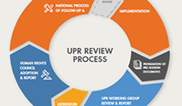





Engagement capacity- OHCHR tools
See http://www.ohchr.org/EN/HRBodies/UPR/Pages/CyclesUPR.aspx
Treaty Specific Trainers Guides, e.g. on CRPD and OPCAT- Preventing Torture- The role of National Preventive Mechanisms
Practical Guide and Study on
National Mechanisms for Reporting
and Follow-up (NMRF)
Manual and Facilitators Guide on Reporting to the Treaty Bodies
Fact Sheets on certain rights, e.g. right to health, right to adequate food, right to water, forced evictions, right to development
E-learning tool on Human Rights Council designed for Government officials from LDCs and SIDS
E-learning tool on Reporting to the Treaty Bodies

Slide 15
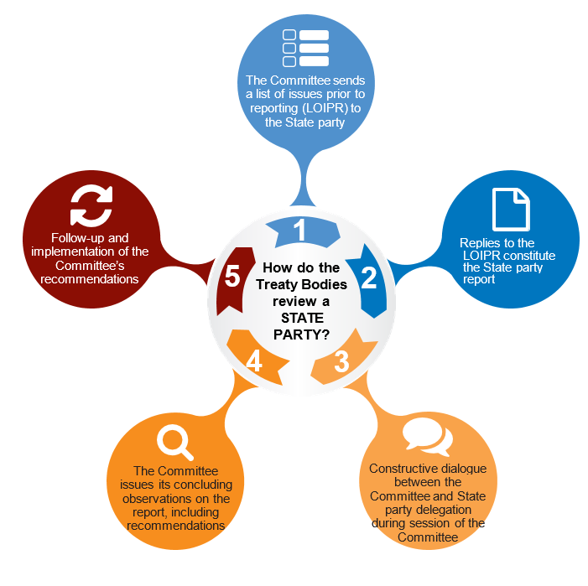
How institutionalized engagement impacts the State’s involvement in the reporting process
Notes:
Effective coordination, consultation and information management throughout the reporting cycle have an impact on effective engagement at every stage of the reporting cycle.

Slide 16
Regional and international developments on NMIRFs

Slide 17
Calls at the international level for NMIRFs
UN GA resolution 68/268 on Strengthening and enhancing the effective functioning of the human rights treaty body system
Group of Friends at HRC and HRC resolution mandating OHCHR to organize five regional meetings to share good practices on NMRFs (HRC Resolution 42/30)
Report of the High Commissioner presented at HRC 50th session
HRC resolution 51/33- October 2022
Report of the High Commissioner presented at HRC 57th session- HRC 57/73
Notes:
There have been a number of endeavours at the international level to establish standing structures at the national level to help better engage with UN Human Rights Mechanisms such as the UPR, Treaty bodies, Special Procedures.
The latest is available on the following page: https://www.ohchr.org/en/treaty-bodies/national-mechanisms-implementation-reporting-and-follow

Slide 18


Notes:
There have been a number of endeavours at the international level to establish standing structures at the national level to help better engage with UN Human Rights Mechanisms such as the UPR, Treaty bodies, Special Procedures.
The latest is available on the following page: https://www.ohchr.org/en/treaty-bodies/national-mechanisms-implementation-reporting-and-follow

Slide 19
Regional and international networks of NMIRFs
2023- network of Portuguese speaking countries
2023-2024- network and communities of practice initiatives in the Caribbean and the Pacific
2024- international network of NMIRFs (Asuncion Declaration)
2024- Marrakech Guidance Framework

Slide 20
HRC report content and findings

Slide 21
HRC report 57/73
  Captures findings of one-day intersessional seminar of 23 June 2023
  Includes additional developments related to NMIRFs incl launch of international network of NMIRFs- May 2024

Slide 22
Institutional set up
  Standing structure established by law or decree or some form of executive decision (Thailand)
  Political leverage- under Office of the President or Prime Minister (Moldova)
  Permanent secretariat, need for the provision of adequate resources (cost-effective means to discharge daily functions and carry out activities) (Kiribati- Philippines, Malawi)
  Diverse representation and membership (both political and technical)- including Ministry of Planning (Tonga)
  Clear terms of reference (clear description of roles and responsibilities) (Portugal)
Notes:
Confirmed practices, there’s a clear link between these practices and the ability of the mechanism to submit reports
Established by law- Thailand, for example, explained that the legal creation of its National Committee on Driving Forward Human Rights Work had helped to rationalize reporting efforts and to overcome the lack of
coordination and weak institutional memory. Prior to the establishment of its standing national mechanism, Thailand had relied on ad hoc drafting task forces for each ratified treaty, which would be dismantled once the report was submitted (HRC report 57/73, para. 11).
Budget: Philippines reported that its mechanism had become fully operational only when its budget was incorporated into that of the Office of the President (HRC report 57/73, para. 17)
Political leverage: Given the importance of a multidimensional and government-wide approach to advance human rights, […] national mechanisms would gain from a higher level of political support, as is the case for the SDG coordination bodies who often sit in the Office of the President or Prime Minister- effective to mainstream HR or SDGs in national and sectoral policies. Examples on political leverage which includes chairmanship at ministerial level: Moldova, Philippines, Angola, Kiribati Thailand or Tunisia.
Terms of reference: Portugal shared that the adoption of clear terms of reference had enhanced information flows, facilitated daily interactions between focal points and increased understanding among ministerial focal points on the expectations related to reporting and follow-up (HRC report 57/73, para. 16).

Slide 23
Membership
  Line ministries including Ministry of planning and planning entities in ministries (political and technical level)
  Focal points from National Statistics Offices (NSOs), Parliament, Judiciary and Sustainable Development Coordination bodies
  Focal points from local and regional governments
  Consultation
  Independent bodies and actors

Slide 24
Mandate
  Engagement through an all-mechanisms’ approach with both international (UPR, TB and SP) and regional mechanisms
  Mainstreaming of HRM recommendations in national development frameworks and sectoral policies.
  Monitoring of implementation (Moldova, Portugal)
  Covering individual communications (replies to communications and Follow-up to Views and decisions- Moldova)- less developed for the moment.
  Other tasks- international mandate (Morocco, Portugal), human rights education and awareness raising and advocacy (Guyana, Morocco, Philippines)
Notes:
Monitoring of implementation is another aspect of the mandate of some national mechanisms, such as the National Human Rights Committee of Portugal. In the Republic of Moldova, the National Human Rights Council monitors the application of international human rights treaties by public authorities and institutions and their compliance with the recommendations of human rights mechanisms. (HRC report 57/73, para. 22).

Slide 25
Information management and promotion of coherence with other implementation and FU processes at national level
  Information management: Added value of using digital tracking tools and platforms
  Improved implementation through increased coherence with other processes- synergies with SDGs and mainstreaming of HR in national/sectoral policies

Slide 26
Issues deserving further unpacking
  Practices to mitigate staff turnover, strengthen institutional memory and ensure retention of skills and knowledge
  Effective use of resources- budget allocation
  Coordination practices that concretely enhance capacity of NMIRFs incl through written contributions from members of NMIRFs and use of digital tracking tools
  Role of local and regional governments and NSOs
  Systematic and sustained collaboration with SDG coordination bodies
  Consultation practices to enable meaningful participation
Notes:
Retention of institutional memory-mitigation of staff turnover: According to Burkina Faso, thanks to a combination of factors such as the standing nature of the national mechanism, its network of standing focal points
designated for each line ministry and institution and the existence of a shared digital platform to facilitate collaboration among contributors. To counter the negative impact of staff turnover, several participants considered that the provision of regular training and capacity-building sessions for civil servants in secretariats of national mechanisms and ministerial and other focal points was needed (HRC report 57/73, para. 15).

Slide 27
Issues deserving further unpacking (cont’)
  Role of NMIRFs in data planning and data collection- respect of HRBAD
  Implementation and follow-up practices around prioritization, human rights mainstreaming in sectoral policies and plans
  Practices to respond to individual communications and to follow-up on Views/decisions
  NMIRFs in Federal systems
Notes:
Are NMIRFs sufficient to ensure implementation of recommendations? Views?

Slide 28
For more information, please contact
ohchr-tbcbp@un.org
Thank you for your attention!

